Slide 1
Market Demand Analysis Using NLP in Urdu Languages.
Group Number: 01
21241057 Malika Muradi
21141064 Basit Hussain
RA: Sania Azhmee Bhuiyan
ST: Abid Hossain

Slide 2
Abstract:
The importance of Urdu sentiment analysis
Applications of NLP in Urdu language
Data preprocessed for cleaning, normalization, and transformation.
Challenges arise due to the scarcity of NLP solutions tailored for Urdu language.
Evaluation of approach's effectiveness using various algorithms
SVM, multinomial logistic regression, random forest: 93% accuracy.
RNN excels among deep learning models: 94% accuracy.

Slide 3
Introduction & Related Work:
Investigated NLP methods for Urdu market demand analysis.
Introduced predictive model using social media data and NLP algorithms.
Importance of studying consumer dynamics in the Urdu-speaking market.
Offers insights for improving offerings to meet customer needs.
Social media sentiment's impact on stock
Machine learning's potential to enhance online shopping experiences
Opportunities for gaining competitive advantage in untapped markets.

Slide 4
Methodology:
Named Entity Recognition
Finding the brand of laptops among the comments
Gender predication:
Python gender guesser package
Crucial due to it’s vary of preferences on different gender
Understanding the preferences based on gender

Slide 5
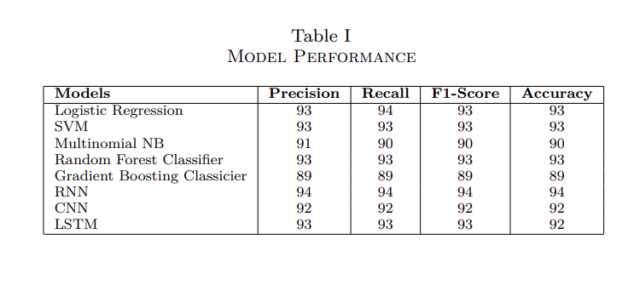
SENTIMENT ANALYSIS

Slide 6
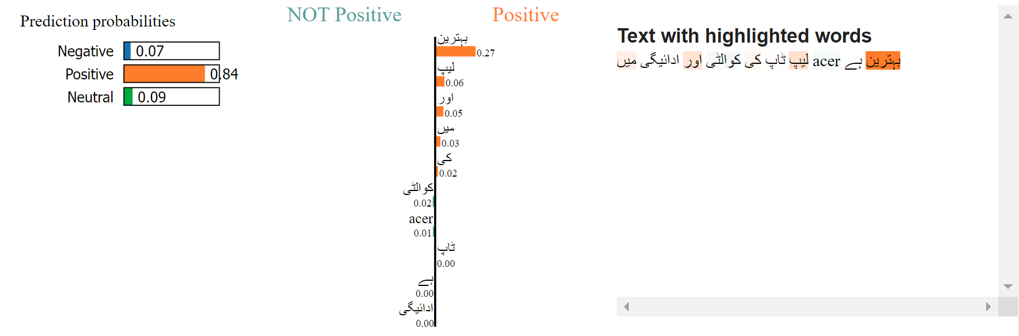
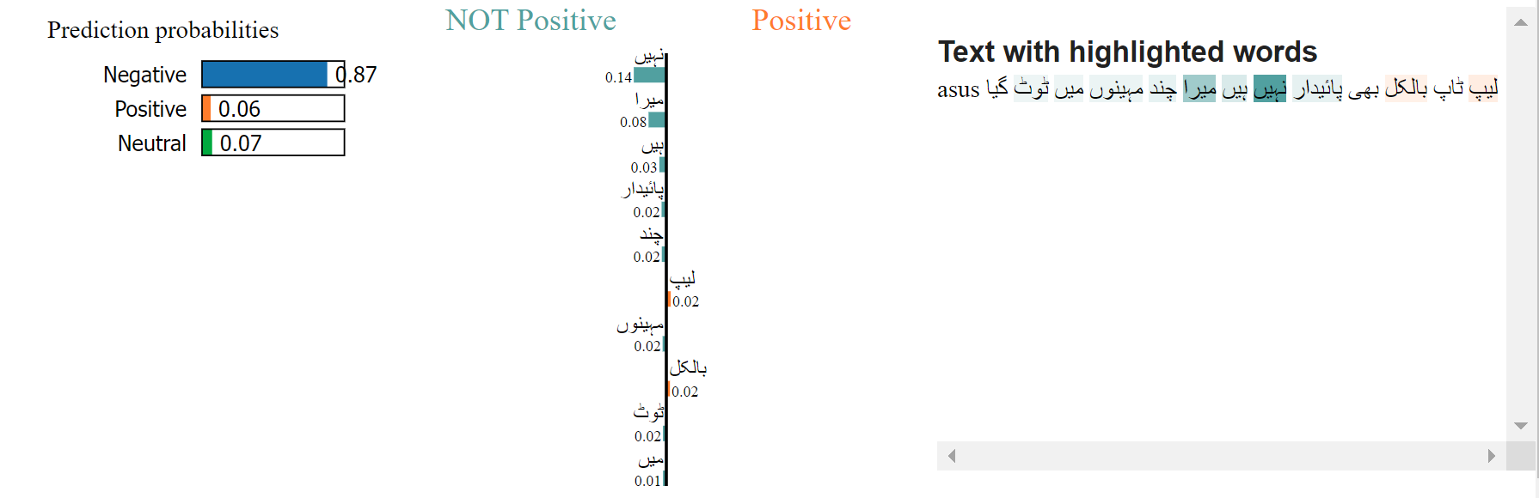
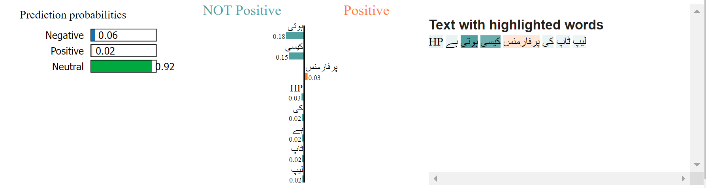
IMPLEMENTATION OF EXPLAINABLE AI

Slide 9
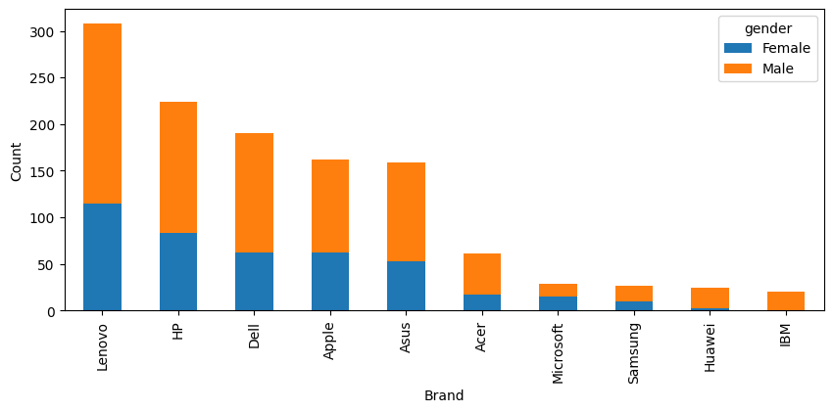
DEMAND ANALYSIS

Slide 10
CONCLUSION & FUTURE DIRECTION
Utilize Various NLP techniques to Analysis Market Demand In Urdu language.
This information informs business strategies in a competitive market.
Discussing future plans, including expanding to other languages and laptop model names.
Mentioning the exploration of additional variables for demand analysis.

Slide 11
THANK YOU

